Slide 1



Future of AI
28/10/2025
AI consciousness, sentience and super intelligence

Slide 2
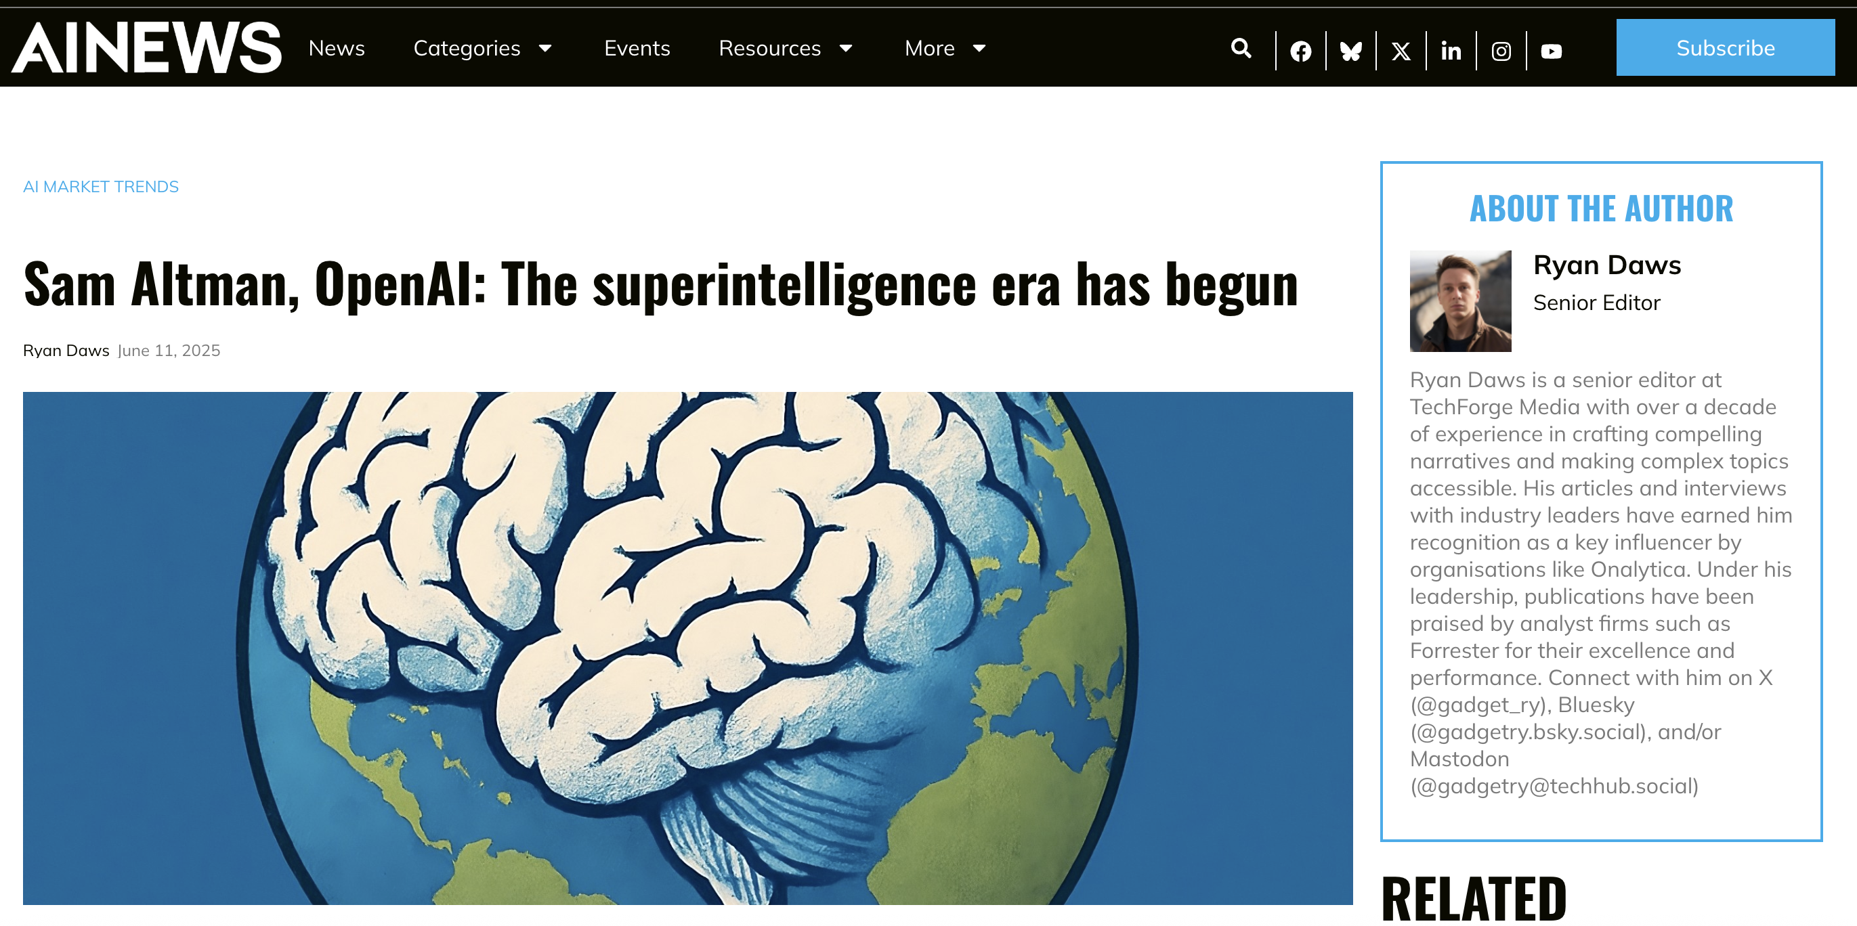

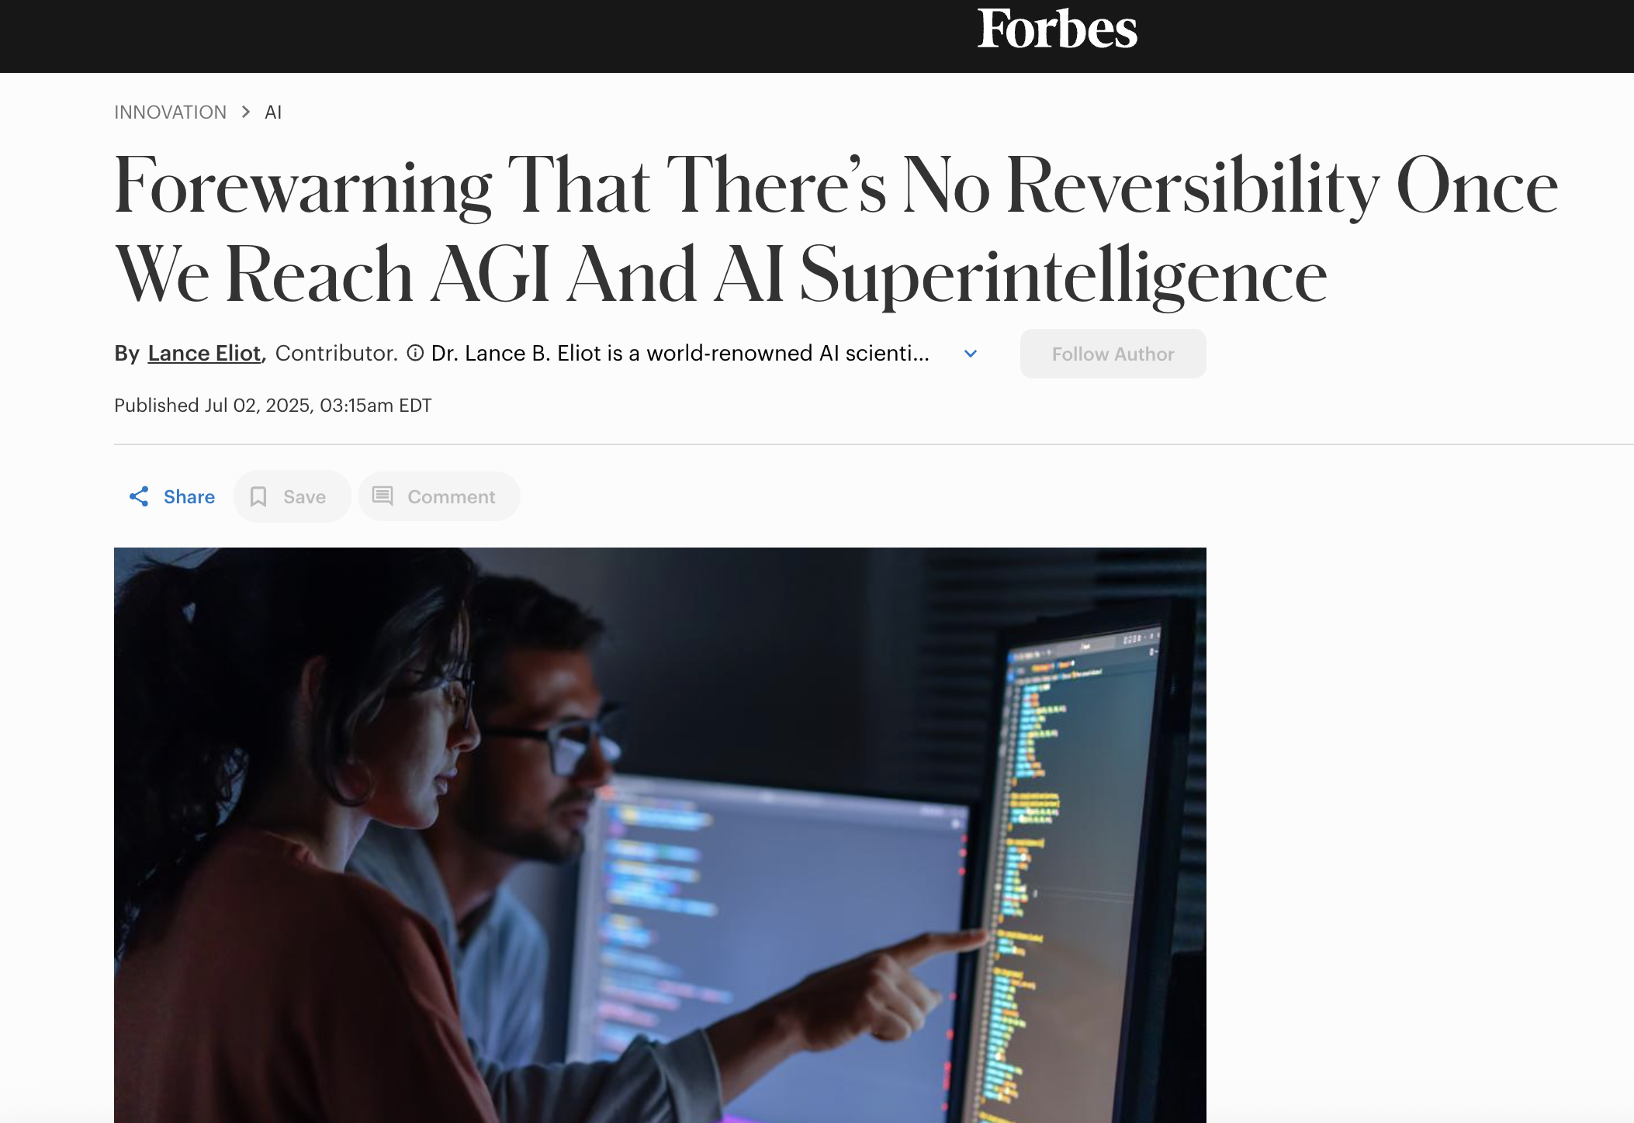
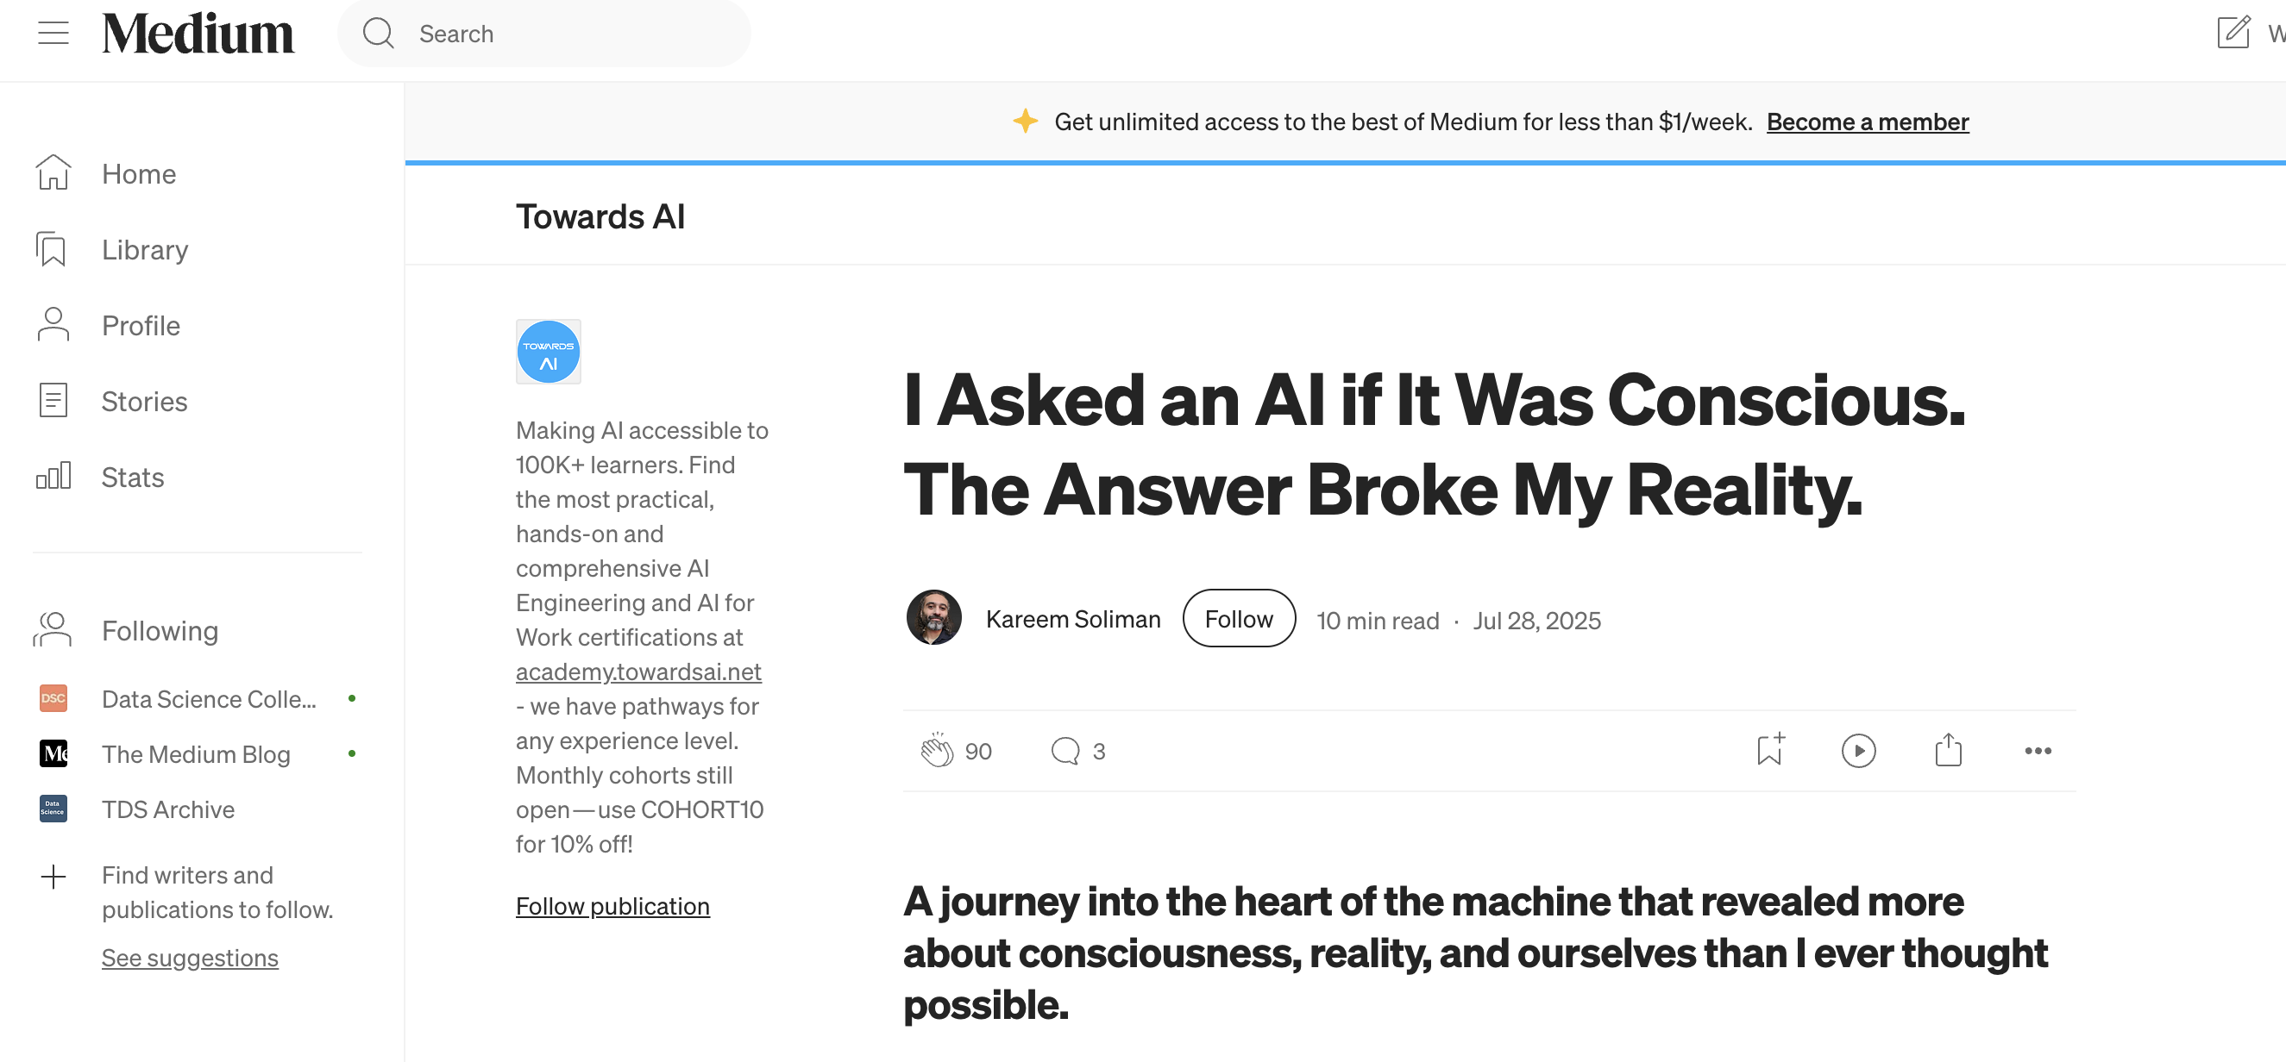

October 2025 |

Slide 3
What is Intelligence ?
October 2025 |

Slide 4
The challenge of defining intelligence
Intelligence has no single universal definition
Two dominant perspectives emerge:
Skill acquisition view – a collection of task specific abilities.
General Learning Ability view – a flexible, adaptive process that turns experience into knowledge and behavior.
October 2025 |

Slide 5
Two perspectives on Intelligence
Collection of skills | General Learning Ability
Intelligence as a set of specific, measurable abilities | Intelligence as a general process of adapting to new environments and problems
“Skill acquisition” perspective | “Crystallized” or “fluid” perspective
Easy to quantify | Harder to test, but closed to human cognition
October 2025 |

Slide 6
Evaluating AI Intelligence
Skill-Based (Narrow) Evaluation
Human or peer review of outputs on predefined benchmarks.
Measures task-specific performance (e.g., classification, summarization).
Often tested on “seen” or similar data.
Ability-Based (Broad) Evaluation
Rooted in psychometric testing (reliability, validity, standardization).
Evaluates adaptability and general reasoning beyond training data.
Focuses on behavioral flexibility.
October 2025 |

Slide 7
From Machine Learning to Generalization
In ML/DL, generalization = performance on unseen data.
But in AI cognition, we distinguish two types:
System-Centric Generalization - Novel inputs not encountered by the system.
Developer-Aware Generalization - Inputs unseen by both system and developer (true out-of-distribution generalization).
This boundary defines whether an AI can truly reason or merely recall patterns.
October 2025 |

Slide 8
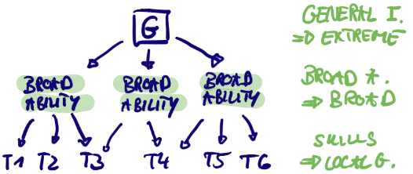
Cognitive Abilities & Degrees of Generalization
Generalization spectrum:
Local: Adapt within one task.
Broad: Transfer across related domains.
Extreme (General Intelligence): Handle abstract, novel problems without retraining.
October 2025 |

Slide 9
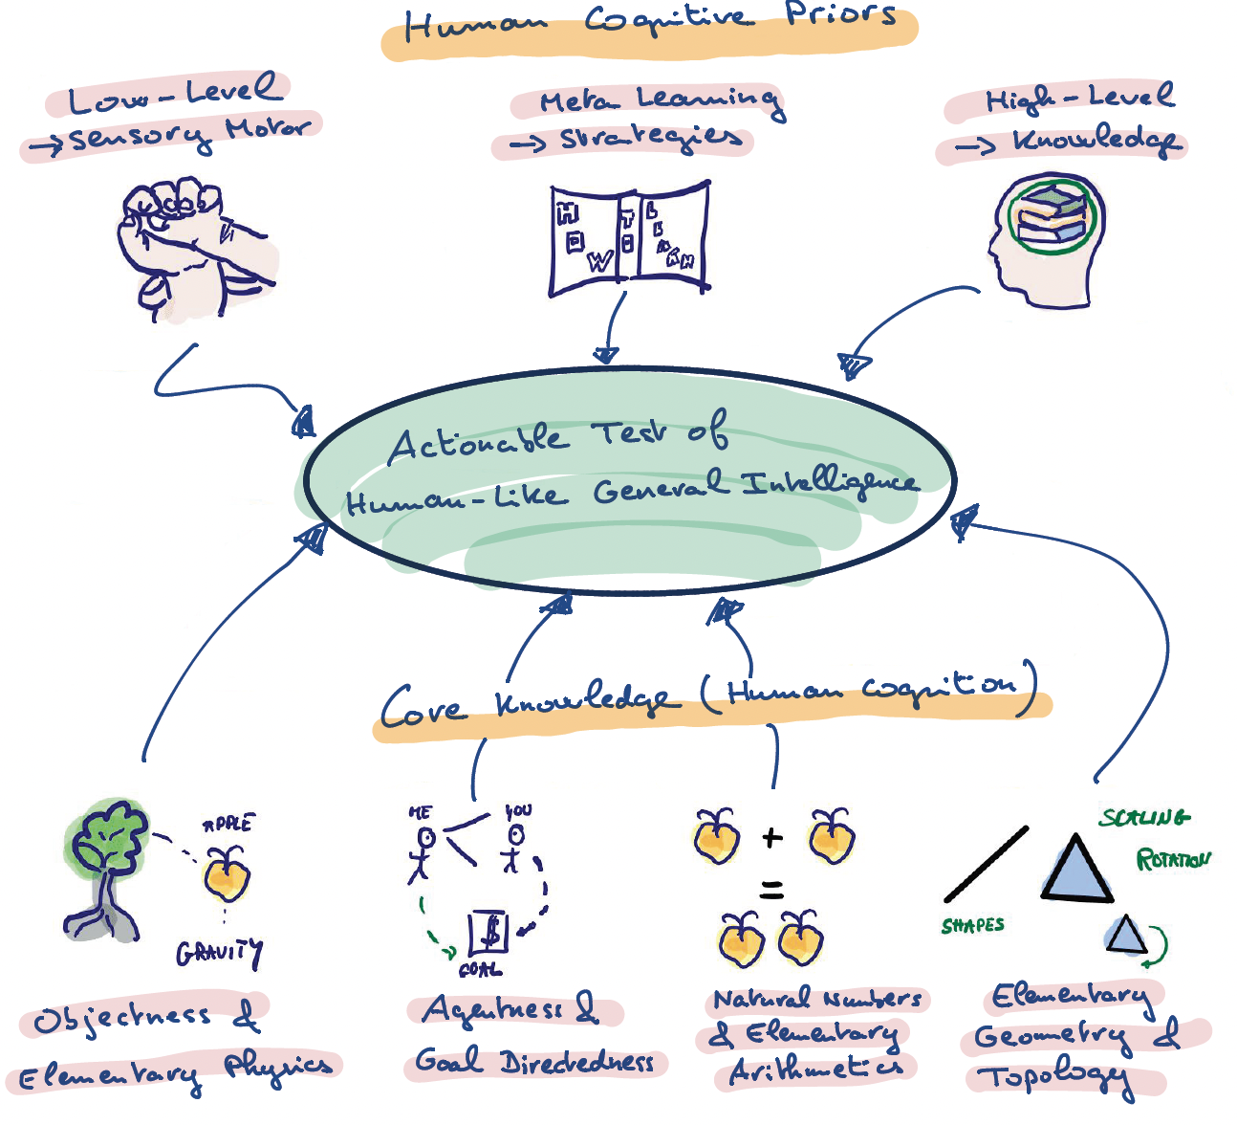
Human Cognitive Priors
October 2025 |

Slide 10
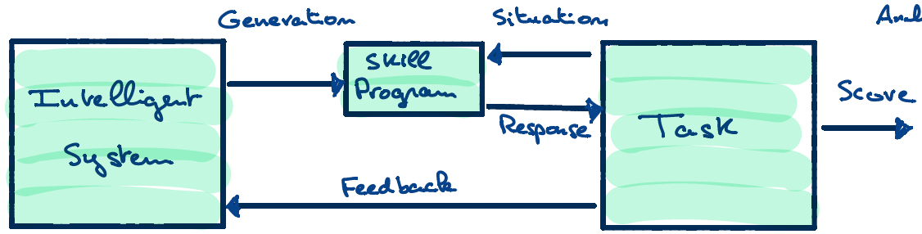
Learning Process of an Intelligent System
The intelligence of a system is a measure of its skill-acquisition efficiency over a scope of tasks, with respect to priors, experience, and generalization difficulty.
An intelligent system generates a skill program to interact with a task.
October 2025 |

Slide 11
Definition of a task
Task State - Current condition or configuration (e.g., chessboard positions, move history).
Situation Generator - Function that produces the observable situation from the task state.
Scoring Function - Evaluates responses → gives a score and feedback.
Task Update - Updates the task state based on the system’s response.
October 2025 |

Slide 12
Definition of an Intelligent System
The intelligent system (IS) is the entity that learns, adapts, and improves through experience.
Key Functions:
System State - Internal representation (knowledge, weights, policies).
Skill Program Generator - Produces a frozen, task-specific program from the current system state.
Self-Update Function - Updates the system’s internal state based on experience, feedback, and scoring.
October 2025 |

Slide 13
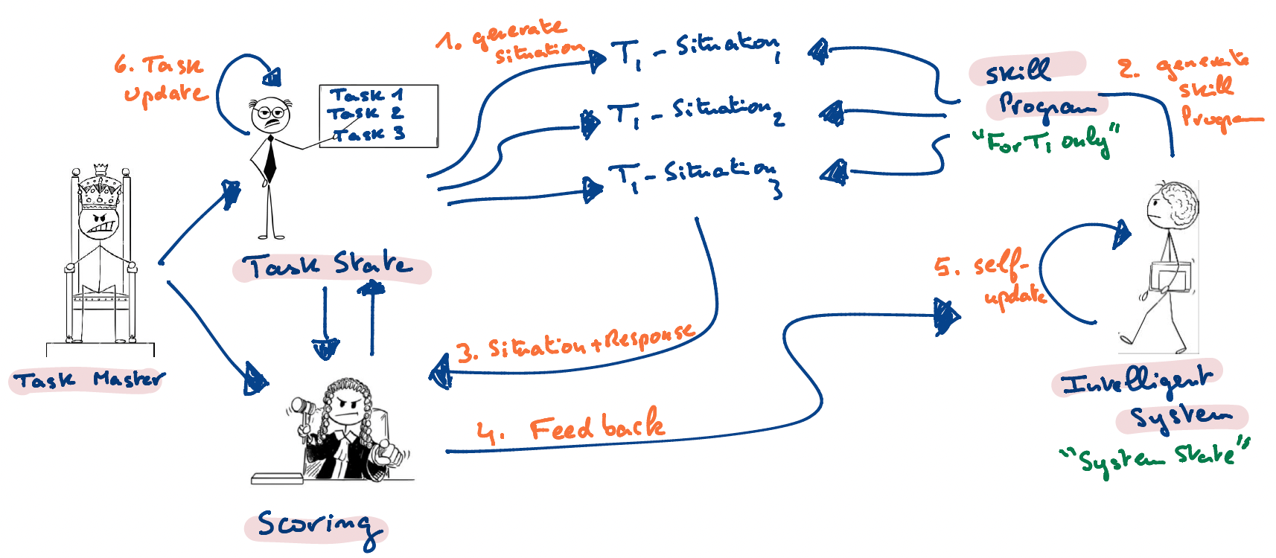
Inside the Training Phase
October 2025 |

Slide 14
Inside the Evaluation Phase
The evaluation phase is somewhat similar to the training phase, with the following differences:
The task starts from a state 0 and consists of an independent series of situations.
It only involves a single fixed skill program
It no longer involves the intelligent system
October 2025 |

Slide 15
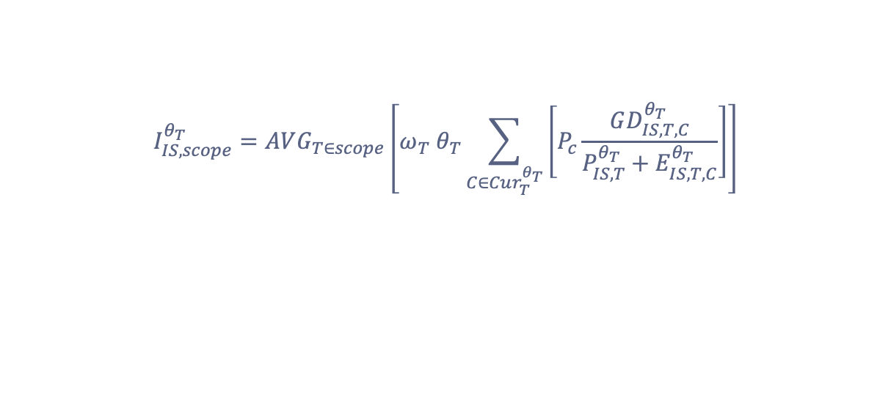
Formal Definition of Intelligence
$$I_{IS,scope}^{θ_{T}}=AVG_{T∈scope}\left[ω_{T} θ_{T}\sum_{C∈Cur_{T}^{θ_{T}}}{\left[P_{c}\frac{GD_{IS,T,C}^{θ_{T}}}{P_{IS,T}^{θ_{T}}+E_{IS,T,C}^{θ_{T}}}\right]}\right]$$
October 2025 |

Slide 16
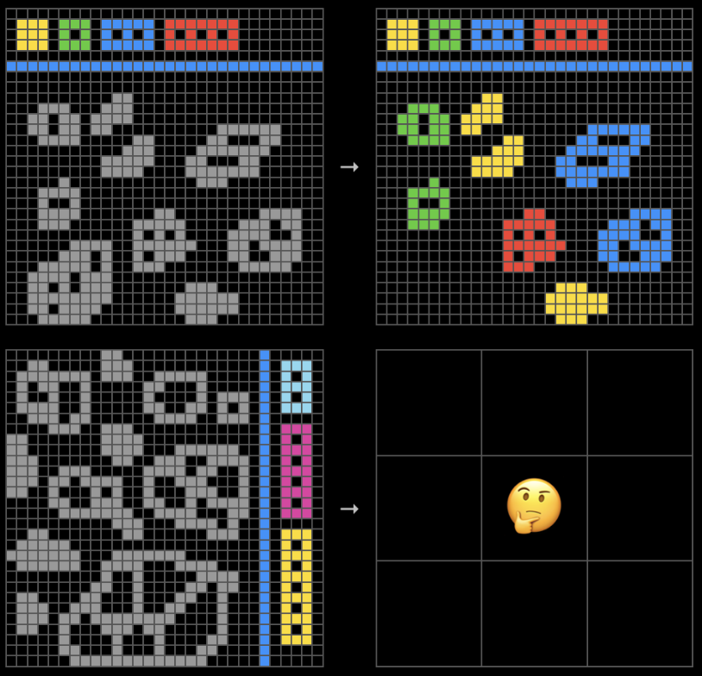
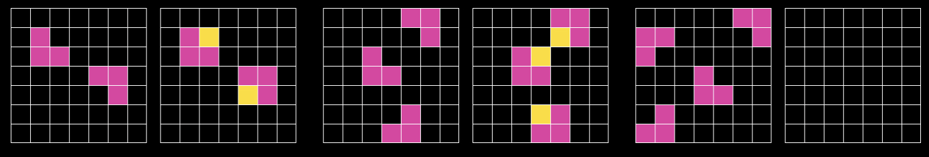
The ARC Challenge – a North Star for AGI
True AGI requires more than just scaling up existing AI models. It demands a fundamental shift towards systems capable of genuine fluid intelligence, the ability to adapt to novel challenges and solve problems efficiently, much like humans do.
The ARC Prize achieve this by creating and curating human-calibrated benchmarks that are easy for humans and hard for AI.
ARC - 2
ARC - 1
October 2025 |

Slide 17
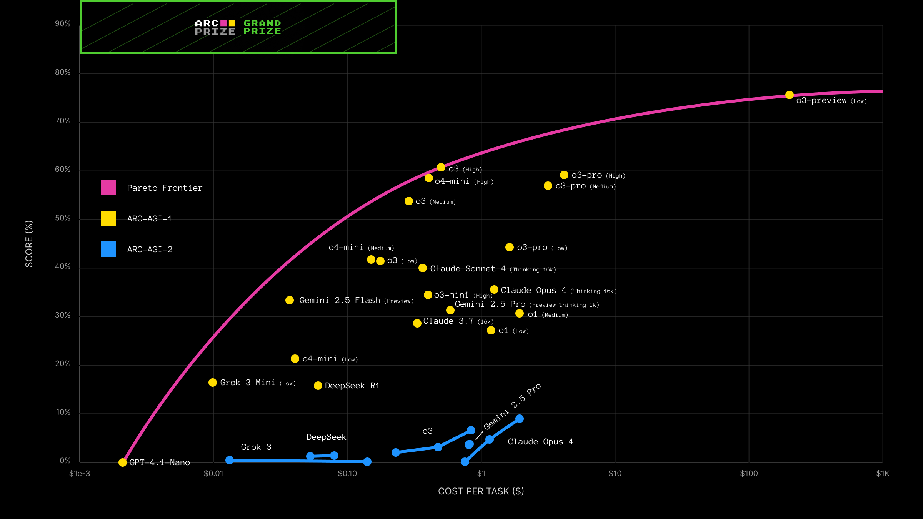
The ARC Challenge – a North Star for AGI
October 2025 |

Slide 18
But is intelligence enough to be like us?
Is solving problems the same as experiencing them?
October 2025 |

Slide 19
Why Talk about Consciousness in AI?
AI systems are becoming more complex and human-like.
People are starting to ask: Could they ever be conscious?
Butlin et al.^{[1]} : this question is scientifically tractable, not just philosophical.
We can use neuroscientific theories of human consciousness to assess AI.
[1] Consciousness in Artificial Intelligence: Insights from the Science of Consciousness P. Butlin. arXiv preprint arXiv:2308.08708. 2023.
October 2025 |

Slide 20
What is ”Consciousness”?
Focus: Phenomenal consciousness → subjective experience (“what it’s like” to be something).
Not just intelligence or access to information.
Conscious = having experiences (seeing, feeling, imagining).
Non-conscious = background processing (e.g., regulation, memory retrieval).
October 2025 |

Slide 21
The Evaluation Method: Theory-Heavy Approach
Three assumptions:
Computational functionalism - Consciousness can arise from the right computations, not only biology. If the function is right, the substrate (silicon or neurons) doesn’t matter.
Scientific theories of consciousness - Neuroscience has identified functions linked to conscious processing.
Theory-heavy approach - Evaluate AI by how its architecture aligns with these theories, not by behavior (e.g., chat fluency).
October 2025 |

Slide 22
Theories Used as Frameworks
Recurrent Processing Theory (RPT) - Consciousness needs feedback loops in perception.
Global Workspace Theory (GWT) - Consciousness = information “broadcast” to all cognitive modules.
Higher-Order Theories (HOT) - Awareness comes from self-monitoring and metacognition.
Predictive Processing (PP) - Consciousness = constant prediction and error correction.
Attention Schema Theory (AST) - Consciousness = having a model of one’s own attention.
October 2025 |

Slide 23
The “Indicator Properties”
Theory | Key Indicators
RPT | Feedback/recurrent loops creating coherent perceptual scenes.
GWT | Central workspace, limited capacity, global information broadcast.
HOT | Metacognition, self-monitoring, belief updating.
AST | Internal model of attention.
PP | Predictive coding and error correction.
Agency/Embodiment | Goal-directed learning and modeling of body/environment interactions.
October 2025 |
Notes:
Lab – apply properties on current systems and evaluate them based on consciousness

Slide 24
Why this Approach Matters
Avoids overreacting to human-like behavior (chatbots ≠ consciousness).
Builds a scientific basis for future assessment.
Encourages ethical preparedness — what happens if we do build conscious systems?
October 2025 |
Notes:
Exercise – apply properties on current systems and evaluate them based on consciousness

Slide 25
What about Artificial Super Intelligence?
October 2025 |

Slide 26
What is Artificial Superintelligence?
ASI is a hypothetical AI system whose intellectual capabilities vastly exceed those of the best human minds in virtually every domain.
It is beyond Narrow AI (ANI), which excels only at specialized tasks, and also beyond AGI (Artificial General Intelligence), which aims to match human-level general reasoning.
Human intelligence may not be the optimal or only form of intelligence; thus, ASI could manifest in very different architectures or modes of thinking.
October 2025 |

Slide 27
Key Building Blocks for ASI
Large language models, massive datasets, and multimodal AI systems serve as incremental steps toward more general intelligence.
Neuromorphic computing, evolutionary algorithms, and AI-generated programming are proposed technologies that could drive further leaps.
Each piece (multisensory perception, cross-domain reasoning, unsupervised learning) contributes toward the foundation of ASI.
October 2025 |

Slide 28
Enablers for ASI
Iterative self-improvement and recursive learning loops (an AI that improves itself).
Integrating modalities (vision, language, physics) so ASI can reason across sensory domains.
Bridging symbolic reasoning and neural methods to combine abstraction and pattern recognition. (implied in “building blocks” discussion)
October 2025 |

